Slide 1
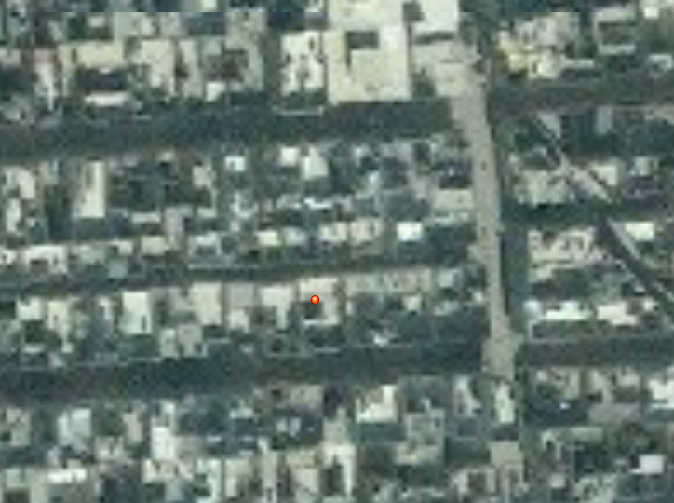

TARGET: JENN DOE
UNCLASSIFIED (EXAMPLE)
3-I ID
NUMBER: UN4533 AREA: SPRINGVILLE STREET: HOUSE:
Targeted by: 3-1 ID Area of Operations: FG 2-2 Trigger: HUMINT
DOI: 06 JAN 2014
TASK: DETAIN
GRID: 37S CA 37813 08314
PHYSICAL DESCRIPTION
Last given bed down grid for Jenn Doe is from 17 APR 2014 IIR 13-DC-12-34-00-75
Sex: Female
Age: 37
Height: 5’5”
Body Comp: Normal
Eyes: Brown
Hair: Brown
Other details: Western style clothing, poss. Southern US accent
3
TARGET INFORMATION
Target Category: Criminal mastermind
Impact: Disrupt international crime syndicate
Possible aliases: Unknown
Vehicle: Unknown
Family: Unknown
Religion: Unknown
STATUS:
PID:
✓
TARGET SUMMARY: Jenn Doe is an international crime operative. She traffics weapons and explosives and has been known to work with terror groups.
Source:
✓
Location:
X
Intnl Cost:
✓
Source: HUMINT
Evidence:
✓
Trigger:
?
UNCLASSIFIED (EXAMPLE)
Last update with: HUMINT

